Slide 1


Gene-based compound heterozygosity approach to identify novel recessive functional variants in EHR based phenotype data
Dr. Shicheng Guo
Population Analytics Group, Janssen Pharmaceutical Companies of Johnson & Johnson, Spring House, Pennsylvania
16/12/2019

Slide 2
Shicheng Guo
2017-2019 Postdoctoral Fellow, Center for Precision Medicine Research, MCRI, Wisconsin
2015-2017 Postdoctoral Fellow, Department of Bioengineering, UCSD, California
2013-2015 Visiting student, University of Texas Health Science Center at Houston, Texas
2009-2015 Ph.D. School of Life Sciences, Fudan University, Shanghai, CN
Guo, S., et al. (2019). Scientific Reports 9(1): 11155.
Guo, S., et al. (2019). Blood 133(17): 1888-1898.
Guo, S., et al. (2017). Nature Genetics 49(4): 635-642.
Guo, S., et al. (2017). Modern Rheumatology 27(3): 441-447.
Guo, S., et al. (2016). The Journal of rheumatology 7: 3.
Guo, S., et al. (2015). Clinical Epigenetics 7(1): 3.
Guo, S., et al. (2014). Clinical Epigenetics 6(1): 5.
Guo, S., et al. (2014). Cancer Medicine 3: 3
Methods and kits for the diagnosis of bladder cancer with urine exfoliated cell
Methods and kits for the prognosis of bladder cancer after surgery with exfoliated cell in urine
2019, Semi-Finalists, AACC’s Disruptive Technology Award, method based on Nature Genetics, 2017.
2018, Computation and Informatics in Biology and Medicine, NLM/NIH Training Fellow (Granted)
2014, First Place Poster, 17th Annual Human and Molecular Genetics Symposium, GSBS, Houston, TX

Slide 3
Outline
Genome-wide linkage/association in disease gene and drug target
Identification of genetic variation for human complex diseases
Linkage analysis to identify acute myeloid leukemia (AML) gene
Compound heterozygote analysis to identify hemochromatosis gene
Contribute to TIDVALE in Janssen Pharmaceutica
Compound heterozygote analysis to UKBB based exome-sequencing data
Multi-omics integrative analysis to identify novel drug targets
Notes:
Automatic medicine

Slide 4
Outline
Human complex disease and Genome-wide linkage/association
Identification of genetic variation for human complex diseases
Linkage analysis to identify acute myeloid leukemia (AML) gene
Compound heterozygote analysis to identify hemochromatosis gene
Contribute to TIDVALE in Janssen Pharmaceutica
Compound heterozygote analysis to UKBB based exome-sequencing data
Multi-omics integrative analysis to identify novel drug targets
Notes:
Automatic medicine

Slide 5
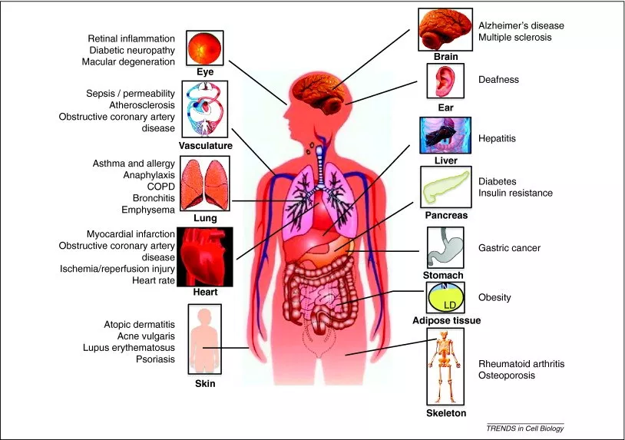
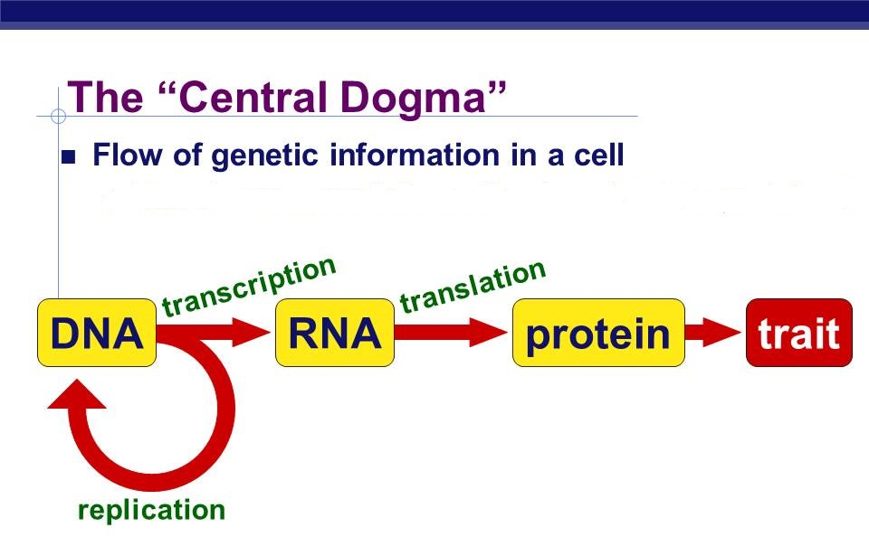
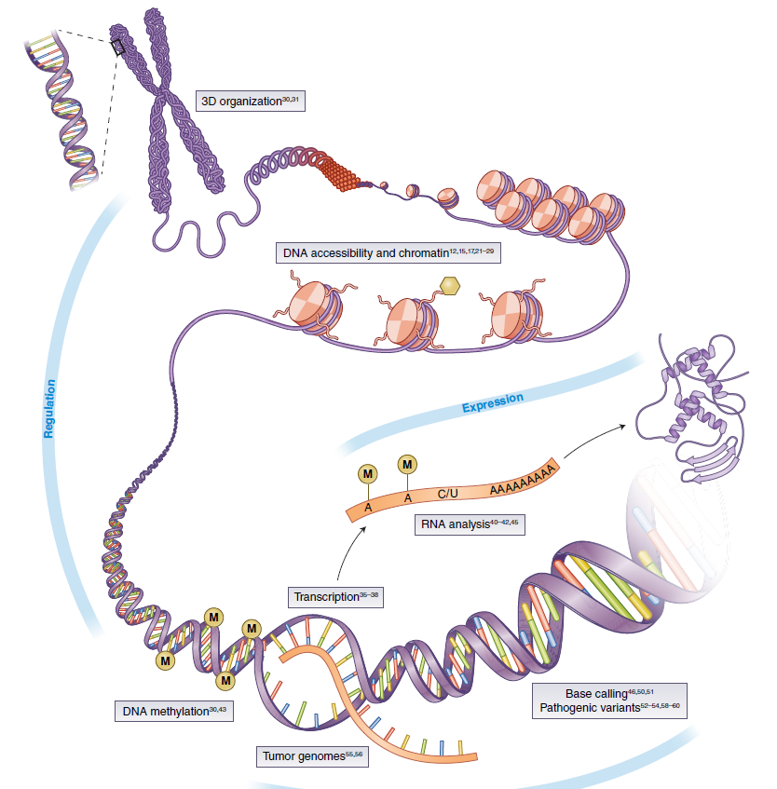
Macro and Micro View of Human Diseases in 21 Century
DNA/RNA/Protein Modification
~ 12,420 total diseases (WHO, 2011)
~ 80 different types of autoimmune diseases
~ 100 different types of human cancers
~ 7,000 rare diseases
Notes:
Let’s check what’s our understanding to disease now. We, human have almost 12 thousand disease including 80 autoimmune diseases, 100 cancers and more than 7,000 rare diseases. Except these, we don’t know how many infectious diseases. However, for all these diseases, we always can find the disease ideologies from tissues or cells. For example, DNA, RNA, protein or its related modifications, such as DNA methylation, miRNA or histone modifications.

Slide 6
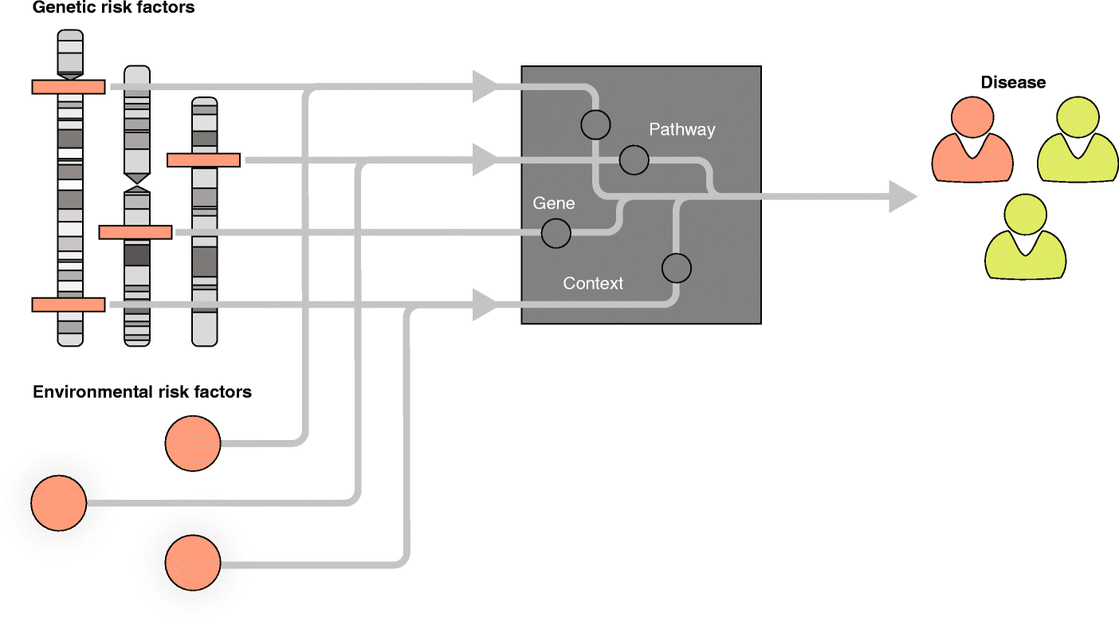
Genetics and Human Diseases: Etiology, Pathology and Phenotypes
Genetic risk factors
EMR
Clinical Phenotypes
Weeks
Years
ICD9
Lab Test
Network
Image phenotypes (w_{x})
Pathological phenotypes (w_{u})
Environmental risk factors(w_{j})
Electroencephalography (EEG)
Electrocardiography (ECG)
Positron Emission Tomography (PET)
Magnetic Resonance Imaging (MRI)
X-Ray radiography image
Ultrasonography image
Epigenetics risk factors(w_{p})
Lifestyle/family history risk factors(w_{q})
Notes:
In order to full understand the disease, the best computational/informatics approach is to integrate all the information for the patients, such as genetic risk factor, environment risk factors, epigenetics risk factors, lifestyle and family history. Meanwhile, we have EHR information, including all kinds of image data, EEG, ECG, PET, ICD9/ICD10.

Slide 7
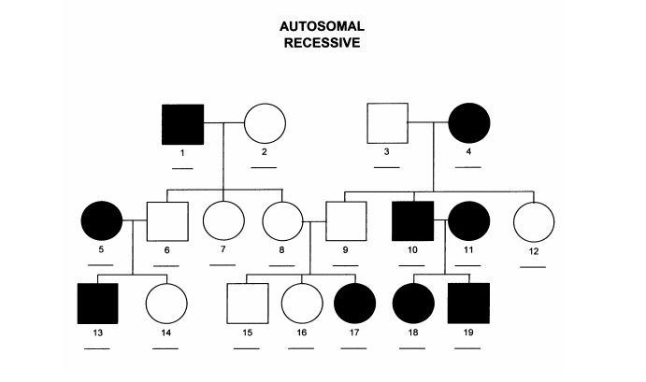
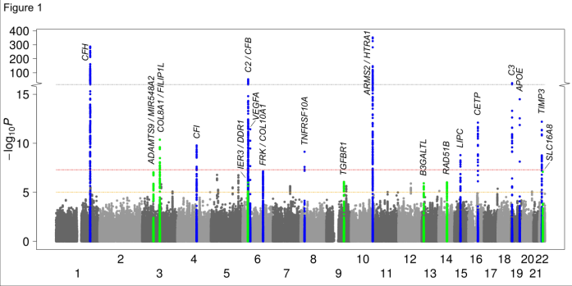
Identification of genetic variation for human complex diseases
Goal: To identify connections between genetic variants and phenotypes
Disease etiology
Refine diagnosis and prognosis
Drug development
Disease prediction
Methodology
Genome-wide linkage analysis to family based genetic data
Genome-wide linkage analysis to non-related population data

Slide 8
Outline
Genome-wide linkage/association in disease gene and drug targets
Identification of genetic variation for human complex diseases
Linkage analysis to identify acute myeloid leukemia (AML) gene
Compound heterozygote analysis to identify hemochromatosis gene
Contribute to TIDVALE in Janssen Pharmaceutica
Compound heterozygote analysis to UKBB based exome-sequencing data
Multi-omics integrative analysis to identify novel drug targets
Notes:
Automatic medicine

Slide 9
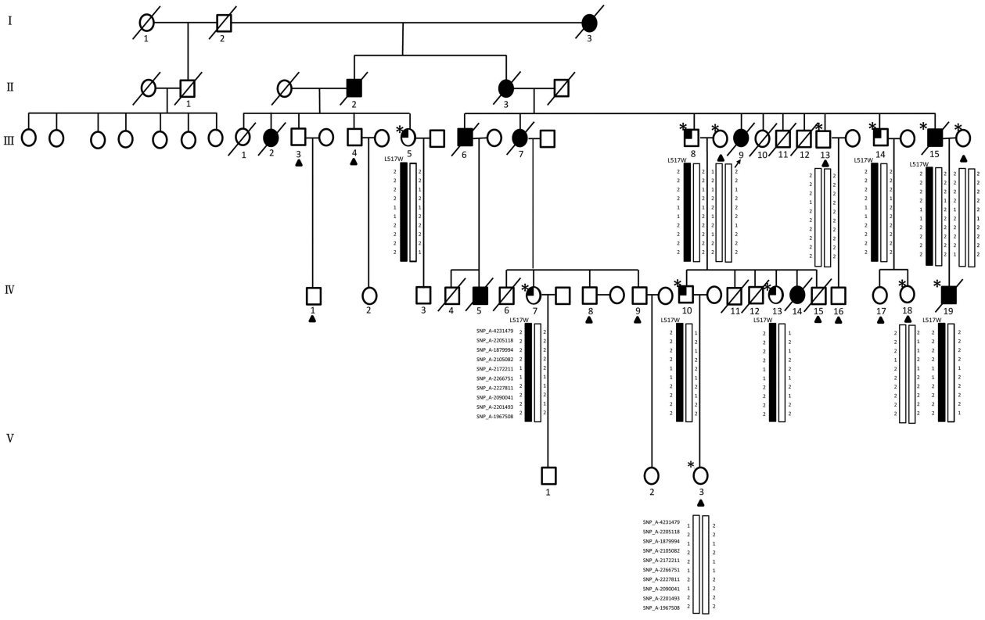
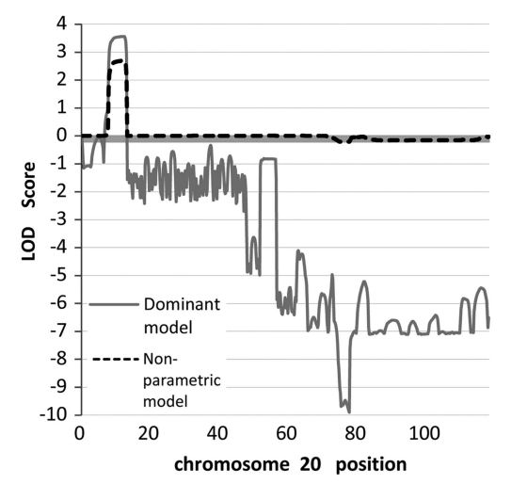
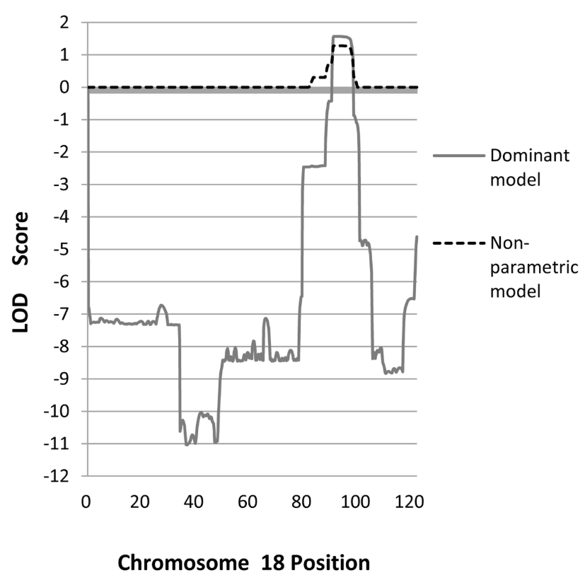
Linkage analysis to identify acute myeloid leukemia (AML) genes: TGM6
20p13, LOD=3.6, P=5x10⁻⁵
18p22.1, LD=1.6, P=7x10⁻³
13 Affymetrix 500K Arrays
LOD: Logarithm of Odds Ratio
Autosomal-dominant AML family with 11 cases in 4 generations
GENEHUNTER with pedigree structure were applied in the phasing
MERLIN with multipoint linkage analysis under dominant model and non-parametric model
2 exonic variants (TGM6 and CENPB), 15 intronic, 15 intergenic and 4 UTR variants
..,Guo S et al.. European Journal of Human Genetics (2015) 23, 218–223

Slide 10
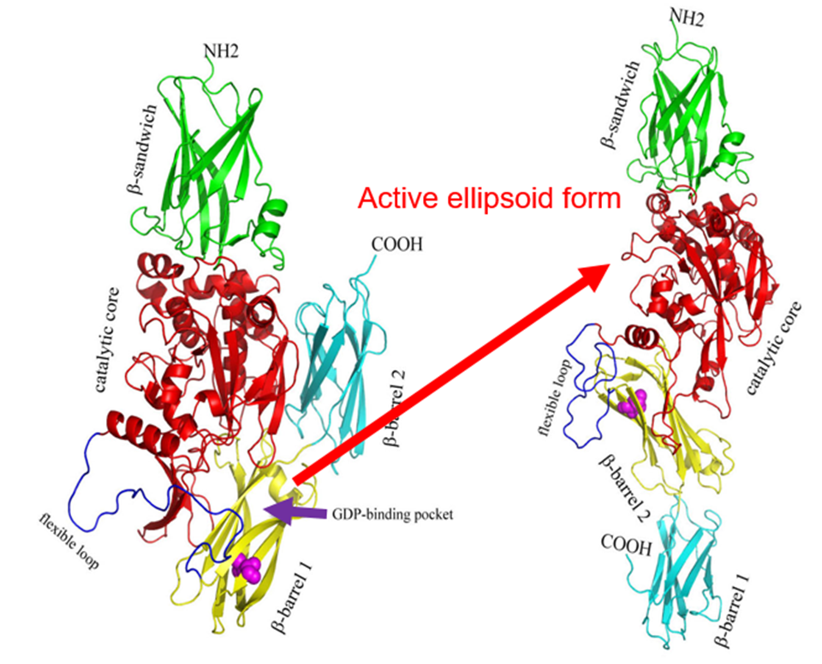
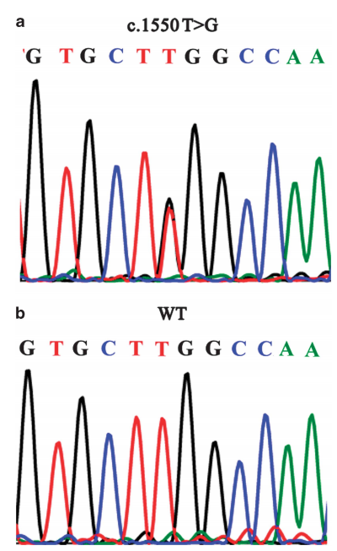
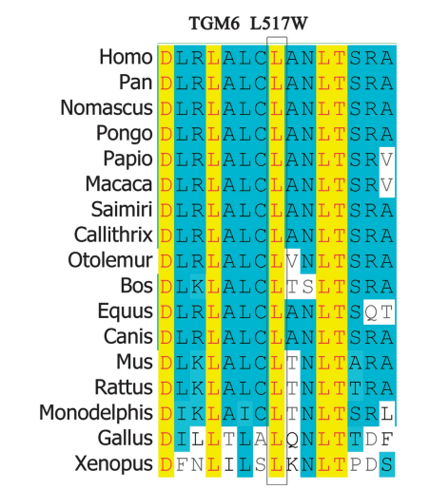
Mechanism of TGM6 mutation cause acute myeloid leukemia (AML)
TGM6 (Transglutaminase-6): L517W occurred in 2 patients and 6 members at potential pre-leukaemic phase, but not in 13 unaffected individuals and 530 ethnically matched healthy controls
L517W is highly conserved position, and predicted as deleterious using SIFT and Polyphen
L517W located in the first b-barrel domain and close to the GDP/GTP-binding pocket
Conformational transition from an inactive compact form to an active extended ellipsoid structure.

Slide 11
Outline
Human complex disease and Genome-wide linkage/association
Identification of genetic variation for human complex diseases
Linkage analysis to identify acute myeloid leukemia (AML) gene
Compound heterozygote analysis to identify hemochromatosis gene
Contribute to TIDVALE in Janssen Pharmaceutica
Compound heterozygote analysis to UKBB based exome-sequencing data
Multi-omics integrative analysis to identify novel drug targets
Notes:
Automatic medicine

Slide 12
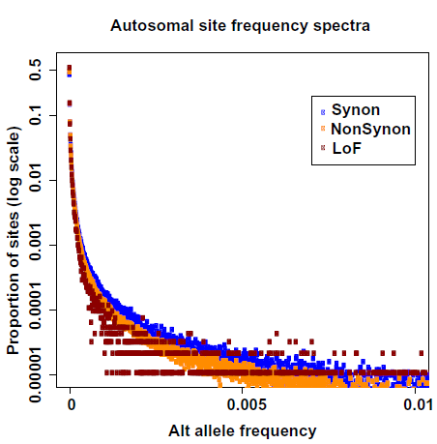
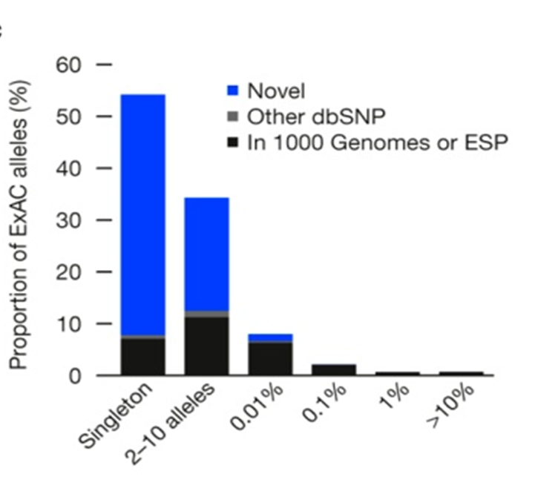
Rare variants in human genome and genetic architecture of diseases
50,726 whole exomes
60,706 whole exomes
Lek et al. (2016) Nature
Dewey et al. (2016) Science
Rare variants are much common in human genome compared with common variants

Slide 13
Exome-wide, Gene-based Recessive Diplotype Scan
Gene A
Gene A
Common variant model:
Additive
Multiplicative
Dominant
Recessive
Codominance
Overdominant
Multiple tests
Considerable heterogeneity among studies
Rare variants model:
Group-based association study (rare variants)
1. Burden test (effect, weight)
2. Kernel-based variance-component test (SKAT)
Compound heterozygosity study
1. Strong assumption
2. Functional variants
 | Case | Control
CH-Yes | A | B
CH-No | C | D
Notes:
Common variants model can also be called single loci model. Group based association or compound heterogyosity can be called multiple-loci model. Burden tests are more powerful when most variants in a region are causal and the effects are in the same direction, whereas SKAT is more powerful when a large fraction of the variants in a region are noncausal or the effects of causal variants are in different directions.

Slide 14
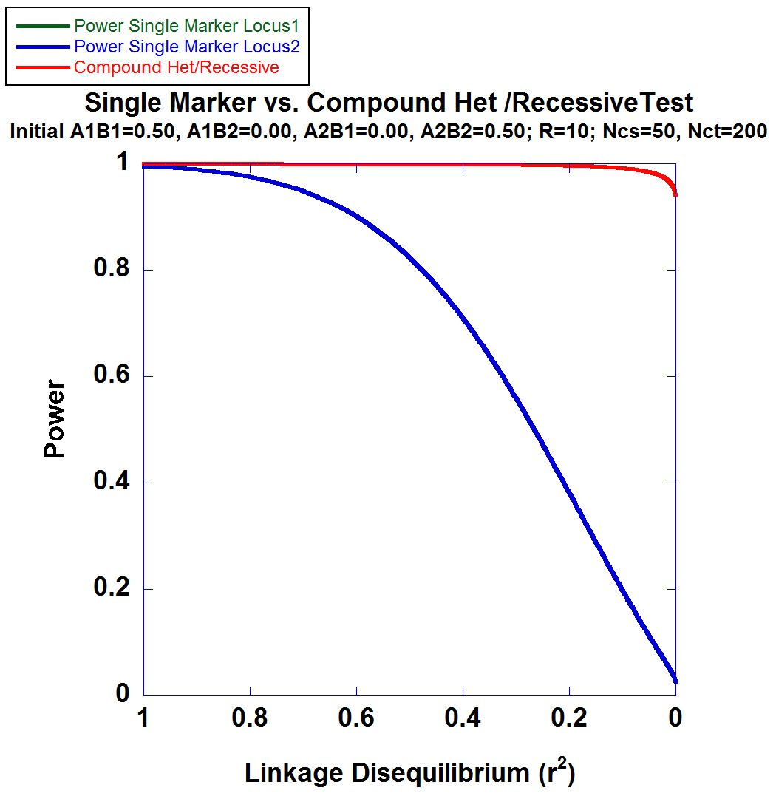
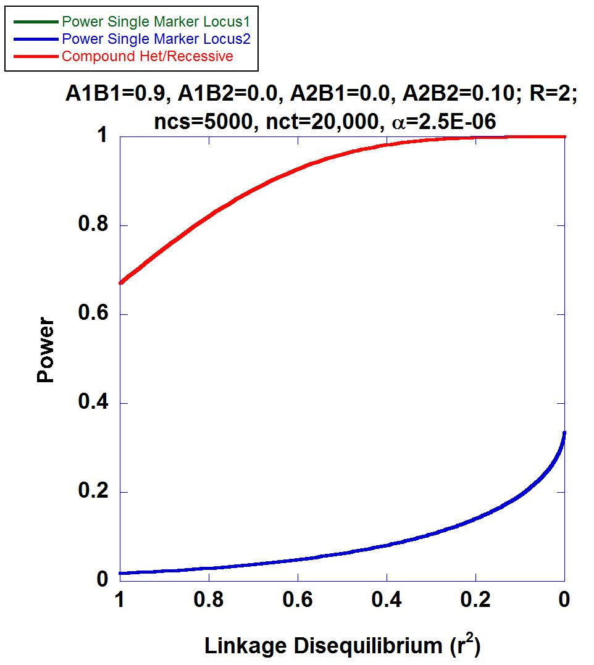
Power Calculations
Power analysis showed compound heterozygote effects were difficult to be identified in traditional way

Slide 15
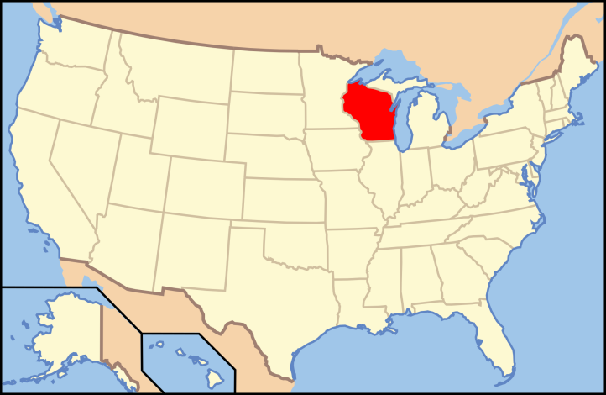
Personalized Medicine Research Project The Central Wisconsin Population
Biobank of 20,000 individuals
Electronic Medical Records >34 yrs
Stored plasma, serum, DNA
Full IRB permission
eMERGE subset (uniform format)
Exome bead-chip with Illumina CoreExome
>80% of the individuals have ancestry to Bavarian settlers (200 years ago)
Low migration
Roughly 5 meiosis since founders

Slide 16

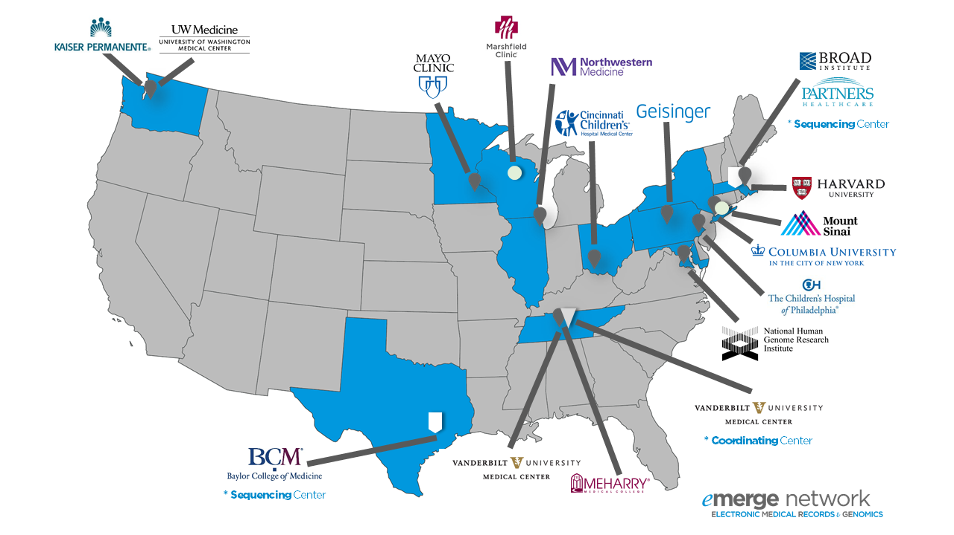
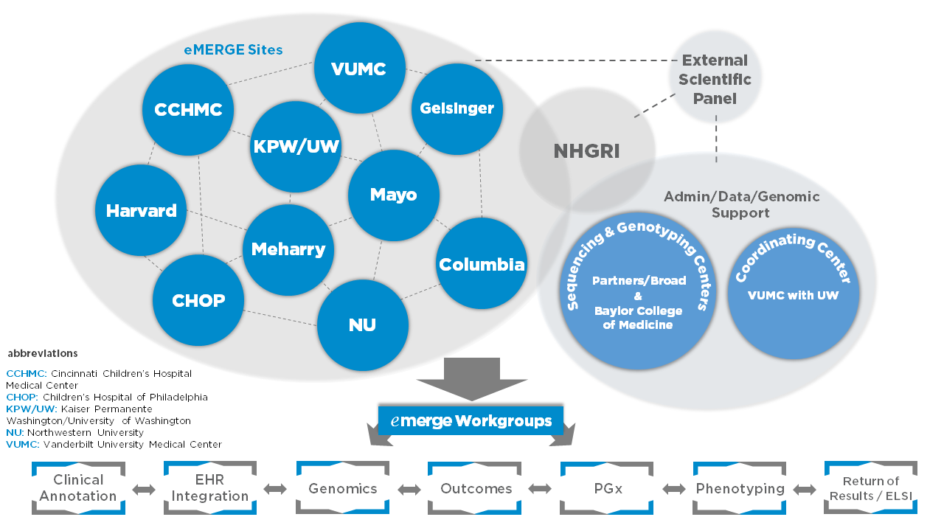
EMR based phenotypes in Marshfield Clinic
Precision Medicine initiative (PMI)
EMR
1960
ICD-9
2007
2019
1916
1985
2015
Marshfield Genetics Maps -1998
ICD-10
eMERGE Network
CPMR

Slide 17
Phenotyping hemochromatosis from EMR in Marshfield Clinic
Inclusion and exclusion criterion:
Case
>=2 instances of ICD9 code 275.0 and > 2 instance of ICD9 code 275.01
>=2 instances of ICD9 code 275.0 and > 2 instance of ICD9 code 275.02
>=2 instances of ICD9 code 275.0 and > 2 instance of ICD9 code 275.03
>=2 instance of ICD10 code E83.119
Serum transferrin level > 48%
Therapeutic phlebotomy or iron chelation therapy
Control
No any instance above (ICD9 275.0, 275.1, 275.2 and 275.3, E83.119) in EMR
No any therapeutic phlebotomy or iron chelation therapy records in EMR
No any serum transferrin level records
ICD9 and ICD10
Lab Test
Treatment
18 cases and 6,896 controls were identified in 20,000 samples

Slide 18
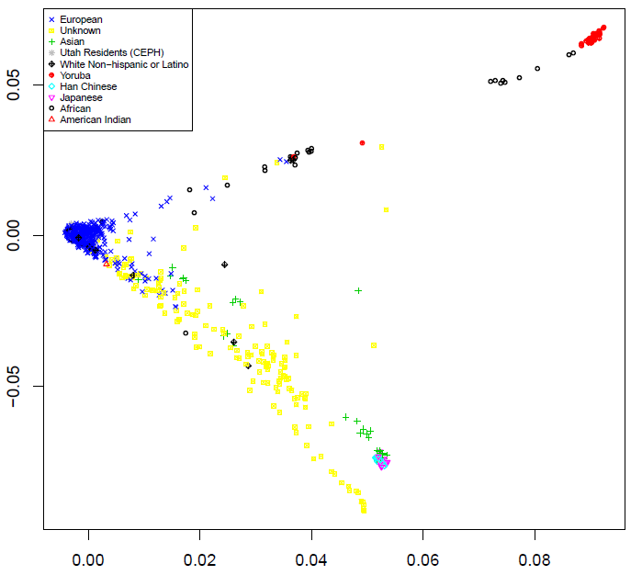
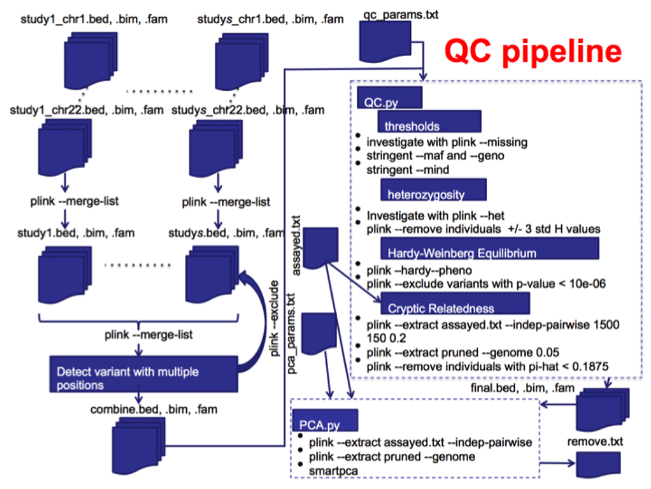
Dataset: 20,000 exome-chip based genotyping data
569,645 SNPs
413,710 SNPs (27.4% removed)
Beagle phasing
Loss-of-function SNPs
413,710 SNPs (27.4% removed)
Phased functional Haplotypes

Slide 19
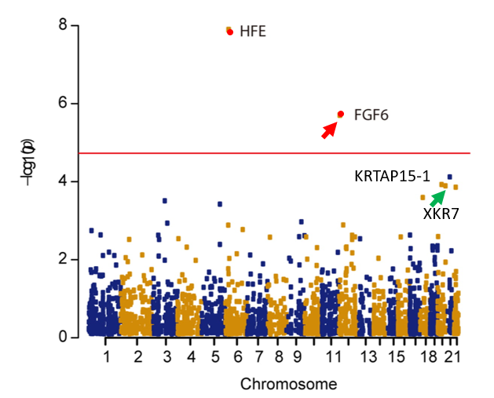
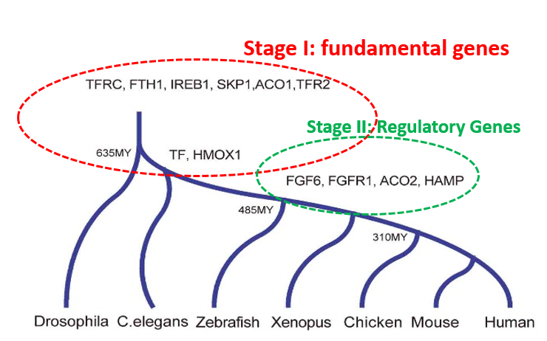
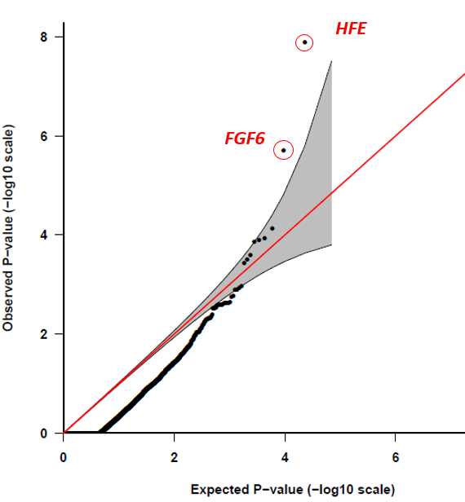
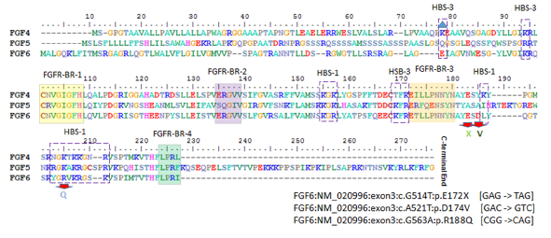
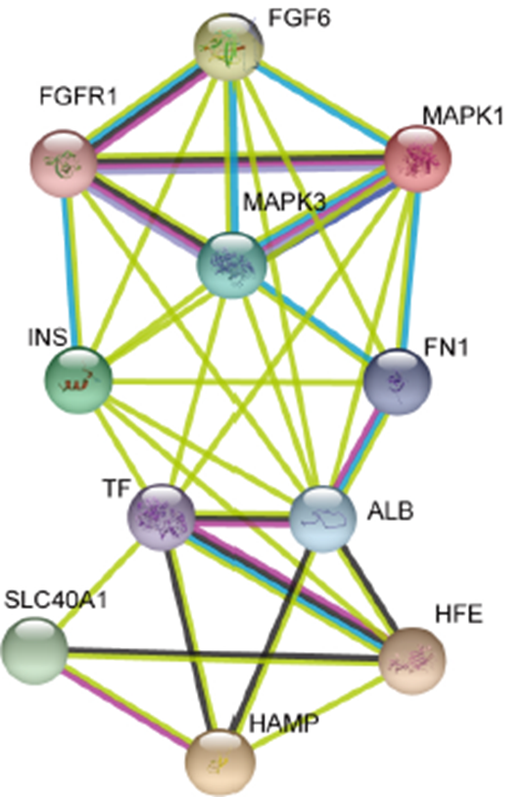
Gene-based recessive diplotype exome scan discovers FGF6 as a iron metabolism gene
OR(FGF6)=22.8
Heparin
Fibroblast Growth Factor 6
Heparin-Binding Growth Factor 6
Iron metabolism
Guo, S. et al.. Blood 133, 1888-1898 (2019).
Notes:
Another story is what we have done recently. We proposed a new statistical method called “Gene-based recessive diplotype exome scan” to identify compound heterozygote loss-of-function disease variants. We apply this method in hemochromatosis selected from PMRP samples. In PMRP dataset, we identified 18 hemochromatosis and 6896 controls. With found in the association study, the most significant genes is a known iron metabolism genes: HFE while the second is quite interesting called “FGF6”. Qq-plot shown FGF6 is significant deviate from expected P-values. FGF6 called Fibroblast Growth Factor 6 and also have another name: Heparin-binding growth factor 6. With compare genomic method, we found iron metabolism genes have two wave evolutions. The stage I genes are belong to fundmental iron metabolism genes. FGF6 is as same as other iron regulatory genes such as ACO2, HAMP. We predicted functional domains of FGF6 and find the 3 variants are located in very important functional domain regions.

Slide 20
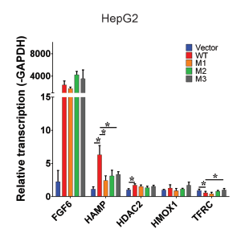
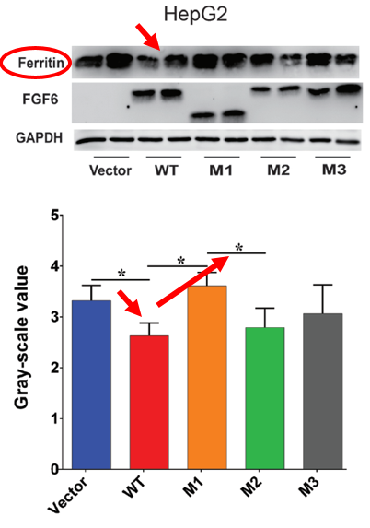
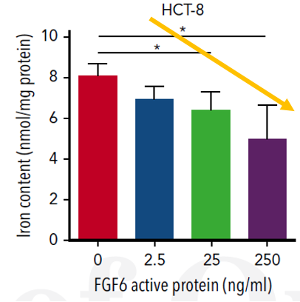
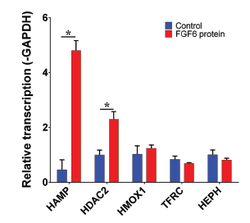
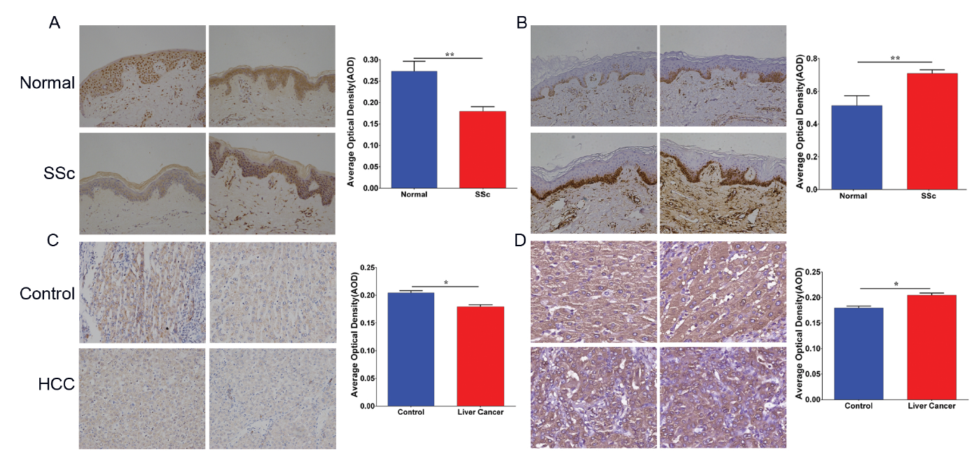
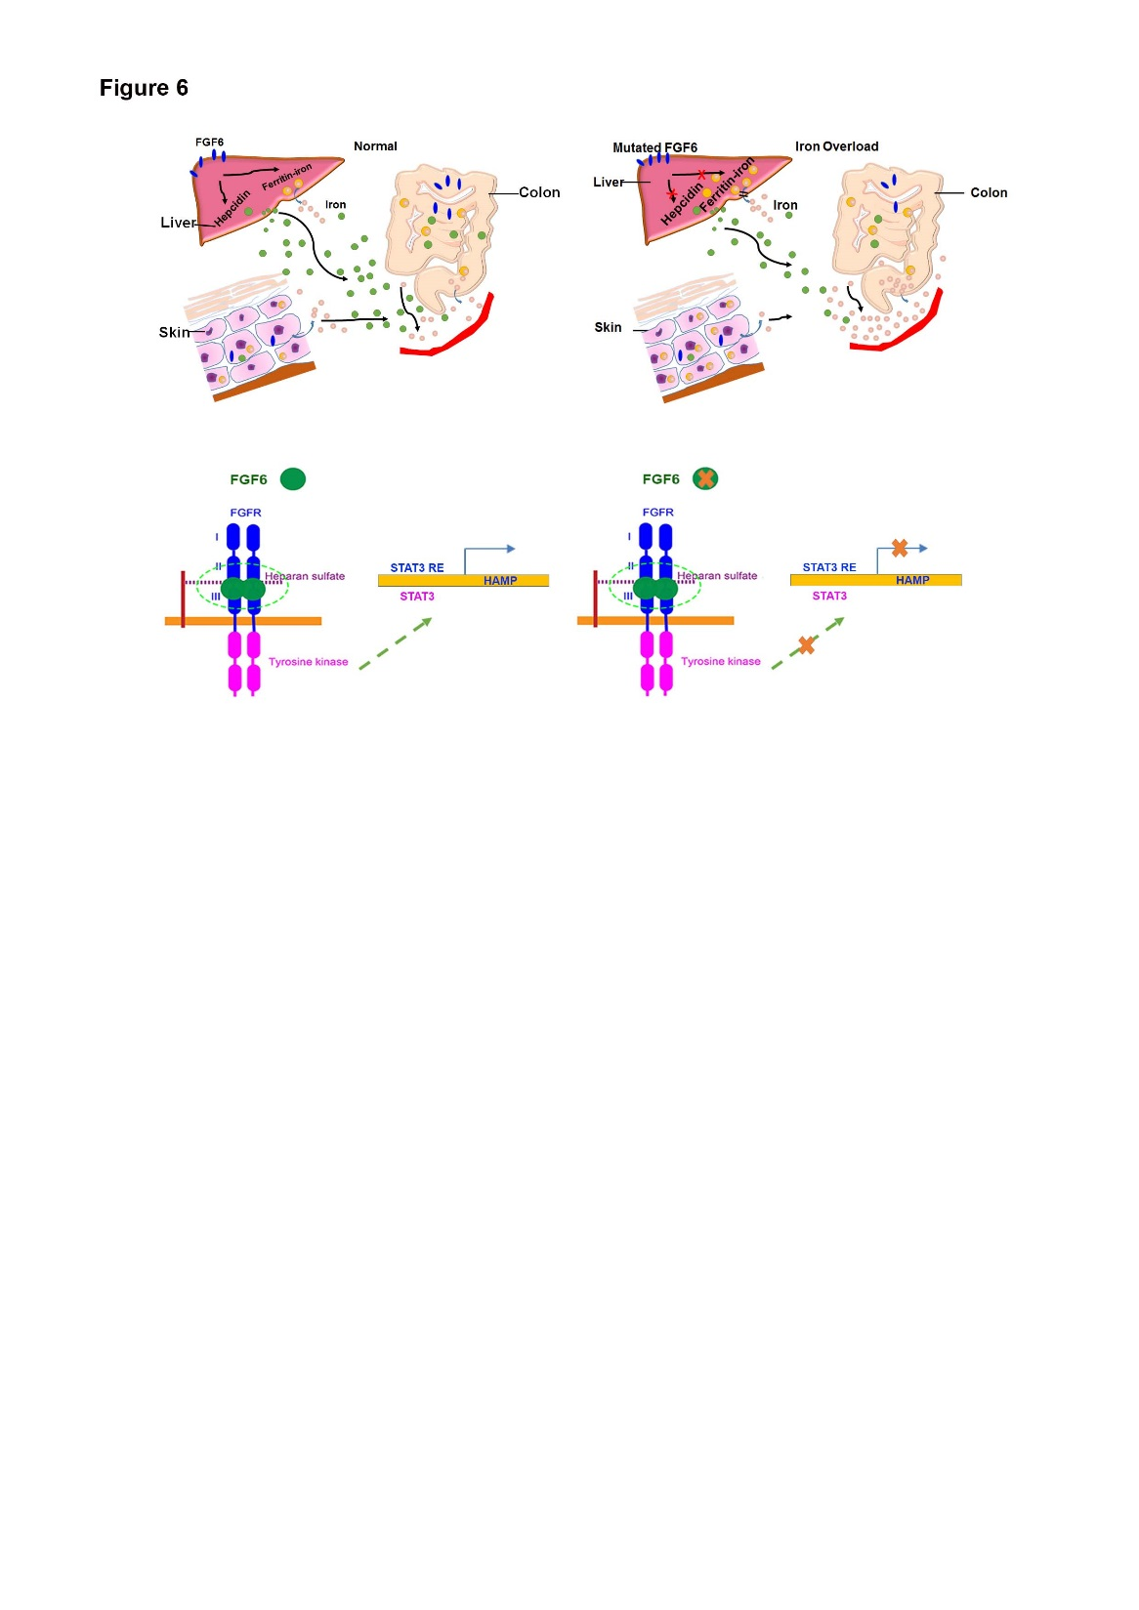
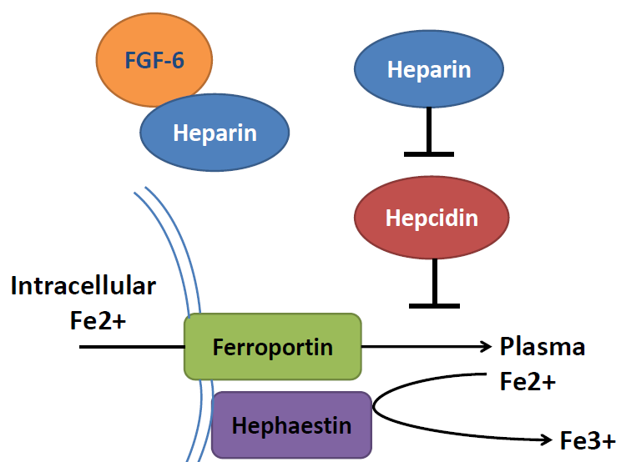
Molecular, Cellular and Immunohistochemistry to Validate FGF6 Functions
CTR
SSc
CTR
Ferrous form
HCC
Ferric form
Guo, S. et al.. Blood 133, 1888-1898 (2019).
Notes:
We then designed several molecular and cellular experiments to validate the FGF6 functions. First, we treat the cell with FGF6 active protein and we found the iron concentration in the cells are significantly reduced as the increasing of FGF6 protein levels. And when we find HAMP gene expression level was significantly increased when we treat cells with FGF6 protein while other iron metabolism cells didn’t have significant changes. We then find if we treat the cells with mutated FGF6, we find the HAMP gene expression cannot be increased. Western blot also confirm that functional FGF6 can decrease iron level In the cells while mutated FGF6 don’t have such function. We also checked some other diseases such as liver cancer and inflammation, and we found in these situations, we find FGF6 have low gene expression and high iron deposition in the cells. Therefore, all the result demonstrate FGF6 play important roles in iron regulation through HAMP. Our findings provide a new insight for the pathology of hemochromatosis and iron metabolism.

Slide 21
Summary and Discussion
Developed a computational pipeline to find recessive compound heterozygote functional disease variants
Advantage:
Identify novel functional disease associated variants
Recessive inheritance variants/phenotypes is much common than dominant phenotypes
Limitation:
Only works in recessive inheritance variants/phenotypes
Depends on the accurate loss-of-function definition/database
Imputation accuracy for rare variants is very low
Phasing to rare variants is not accurate
The variants are sparse for certain genes (array data) which will be better for exome-sequencing data
Require better functional variants annotation
Whole-exome-sequencing data
Genome-wide sequencing

Slide 22
Outline
Human complex disease and Genome-wide linkage/association
Identification of genetic variation for human complex diseases
Linkage analysis to identify acute myeloid leukemia (AML) gene
Compound heterozygote analysis to identify hemochromatosis gene
Contribute to TIDVALE in Janssen Pharmaceutica
Compound heterozygotes analysis to UKBB exome array/sequencing data
UKBB and multi-omics integrative analysis to identify novel drug targets
Notes:
Automatic medicine

Slide 23
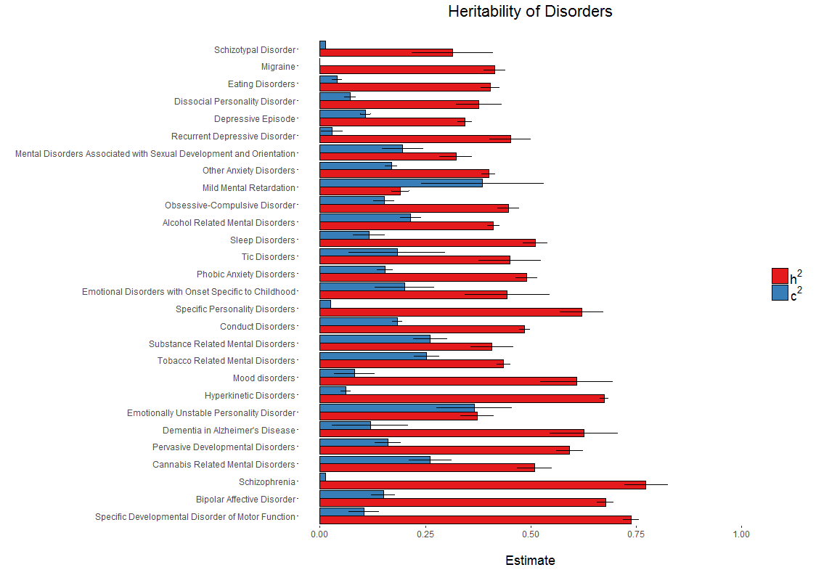
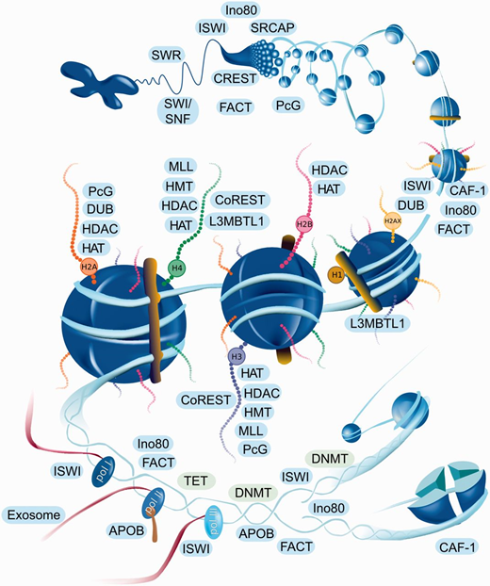
Aim 1: Compound heterozygotes based pheWAS to UKBB data
Heritability (h²)
Shared environmental effects (c²)
Polderman et al. (2015) Nature Genetics, 47(7), 702-709.
Medvedeva, Y.A. et al. Database (Oxford) 2015

Slide 24
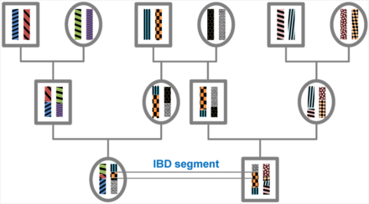
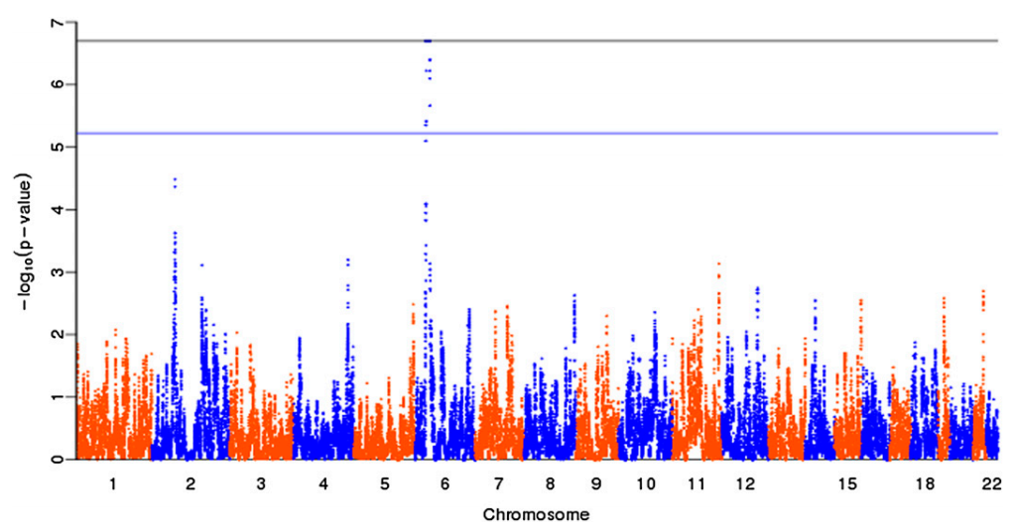
Aim 2: Identity-by-descent (IBD) segments based pheWAS to UKBB cohort
32.6% individuals in UKBB have at least one relatives
DMR and EHR are informative to construct pedigree structure
Rare variants tend to be more recent and more likely to have recent shared ancestry
Identity-by-descent (IBD) based association have higher power in (Rare > Common)
Sharon R. Browning and Elizabeth A. Thompson, Genetics, Vol. 190, 1521-1531

Slide 25
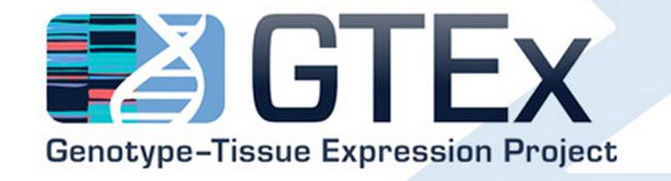
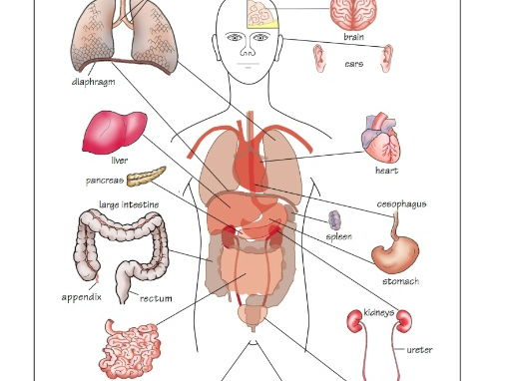
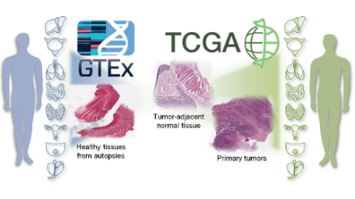




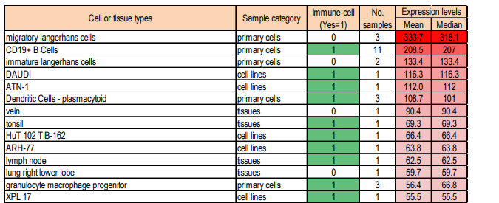
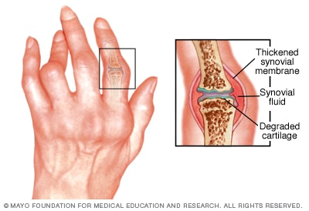
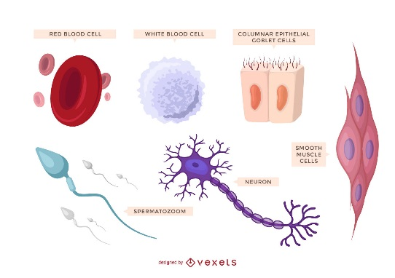
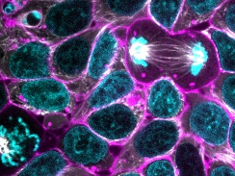
Aim 3: GWAS and multi-omics based drug target discovery
GWAS do not generate drug targets directly and cannot identify novel drug targets without Multi-Omics data
Gene expression, pathway, network, epigenetic regulation, and tissue deconvolution is important for target discovery
PheWAS identified phenotype assocatied variants
Tissue specific and disease associated Genes
Tissue and phenotype deconvolution
L1000

Slide 26
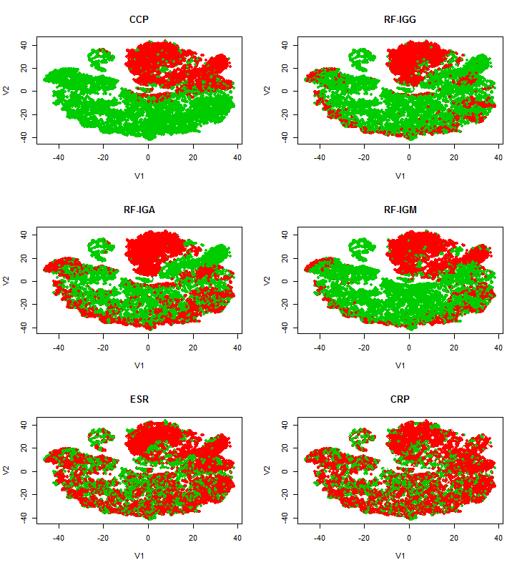
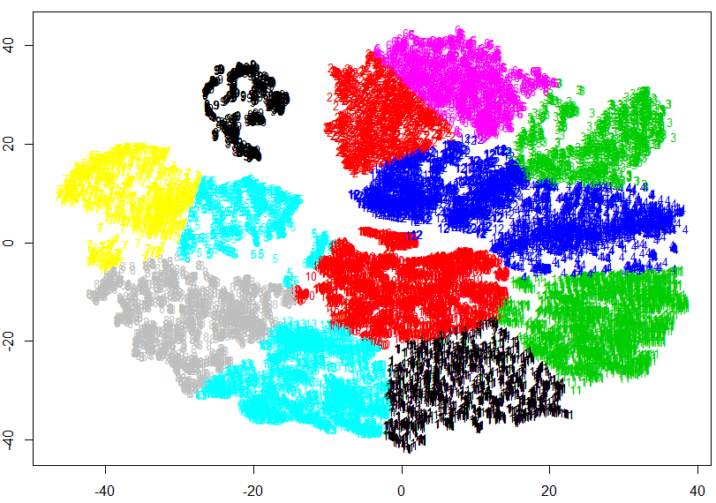
Aim 4: GWAS study to specific disease heterogeneity subset
Anti-CCP
RF-IGG
ESR
CRP
RF-IGA
RF-IGM
10,000 Rheumatoid arthritis EMR
52 clinical features
t-distributed stochastic neighbor embedding (t-SNE)
K-means cluster (N=12)
Unpublished data, Guo, 2019

Slide 27
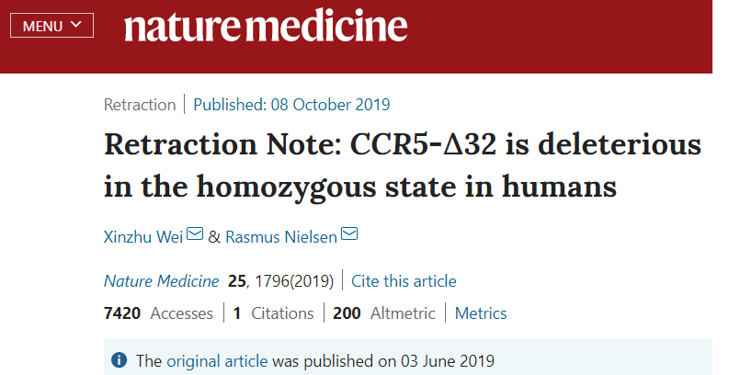
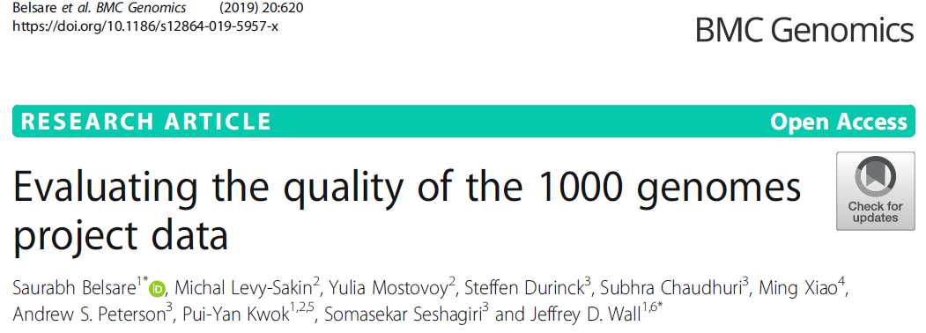
Challenge: low data quality both in genotyping and phenotyping
Regeneron Seal Point Balinese (SPB)
Retracted ~ July 2019
Genotyping calling bias
10th December, 2019
Functionally Equivalent pipeline (FE)
Retracted or update
Technique quality control, negative and positive control
should be set as much as possible

Slide 28
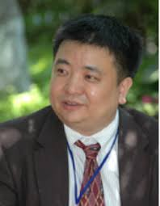

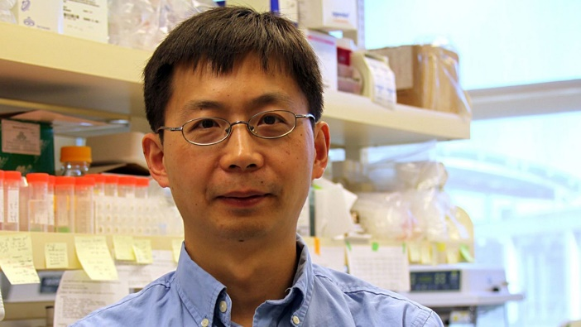

Acknowledgements
Dr. Li Jin
Fudan University
Dr. Momiao Xiong
University of Texas
Dr. Kun Zhang
UCSD
Dr. Steven Schrodi
MCRI
2009-2015
2013-2015
2015-2017
2017-2019
Shanghai, China Houston, TX San Diego, CA Marshfield, WI

Slide 29
Thanks and Questions
Dr. Gunaretnam Rajagopal
Dr. Mary Black
Dr. Alessandro Porrello

